Slide 1
Inventory System
By: Diana D. Magno

Slide 2
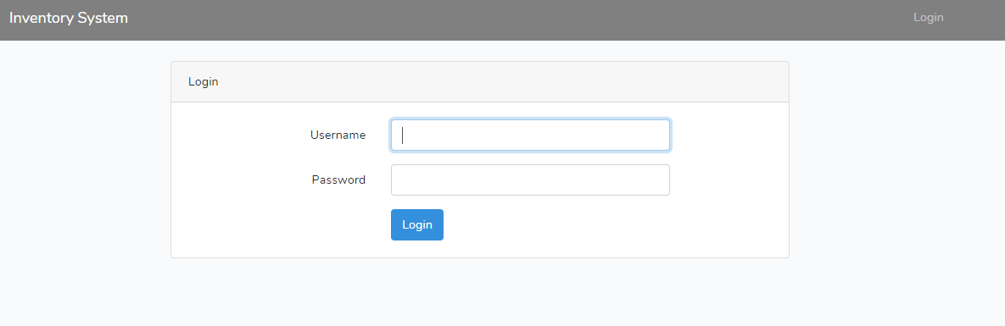
Login Page

Slide 3
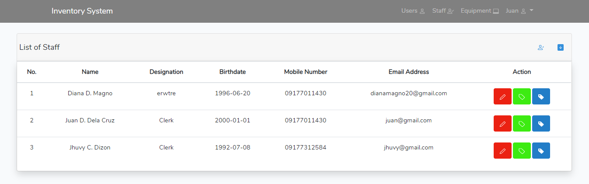
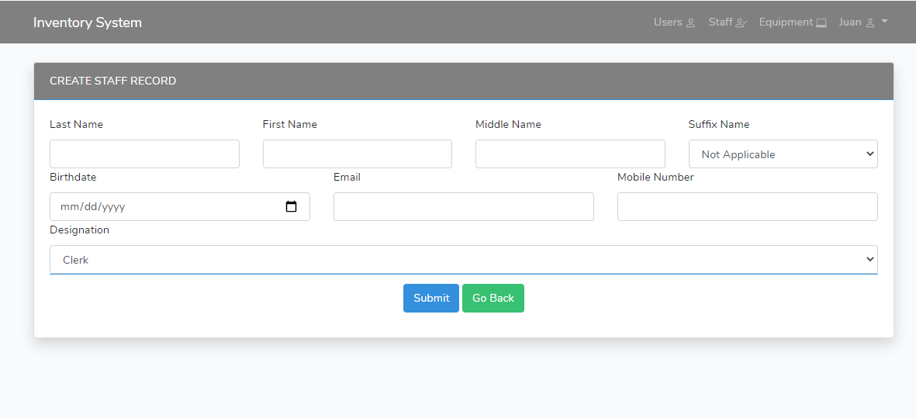
List of Staff
1
4
Legend:
Create New Staff Record
Extract CSV file
Edit Staff Record
List of Assign Equipment/s
List of Return Equipment/s
3
2
5

Slide 4
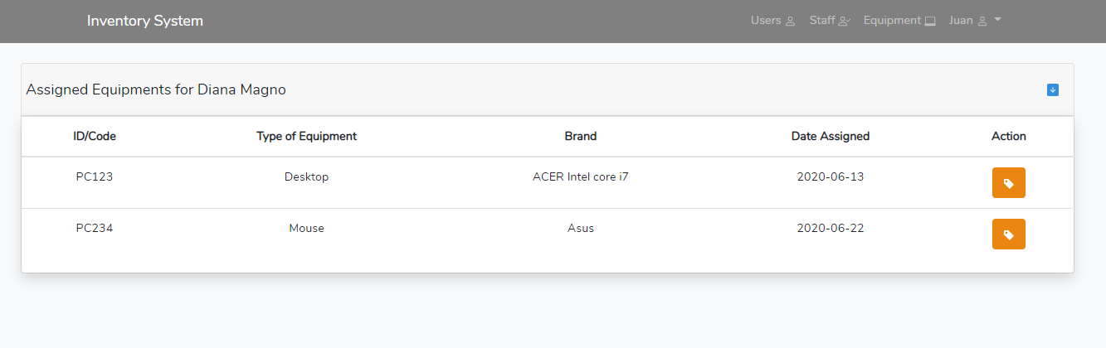
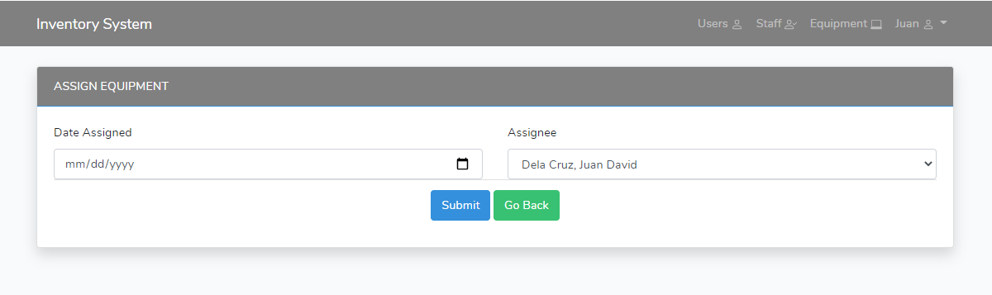
List of Assigned (List of Staff>Assign Button)
Legend:
Return Equipment Form
Extract CSV file
1
2

Slide 5
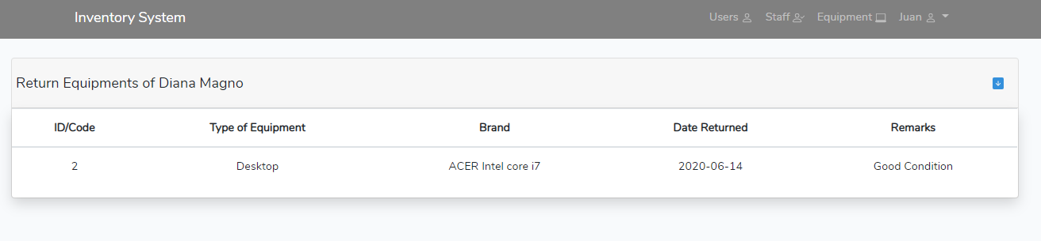
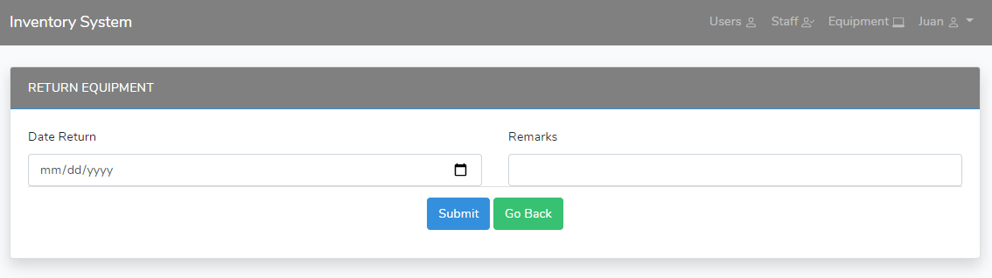
List of Returned (List of Staff return button)
1
Legend:
1. Extract CSV file

Slide 6
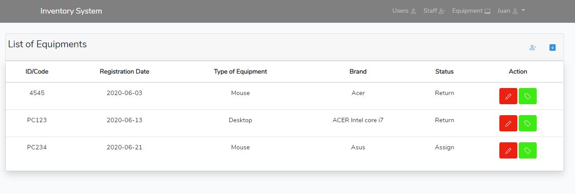
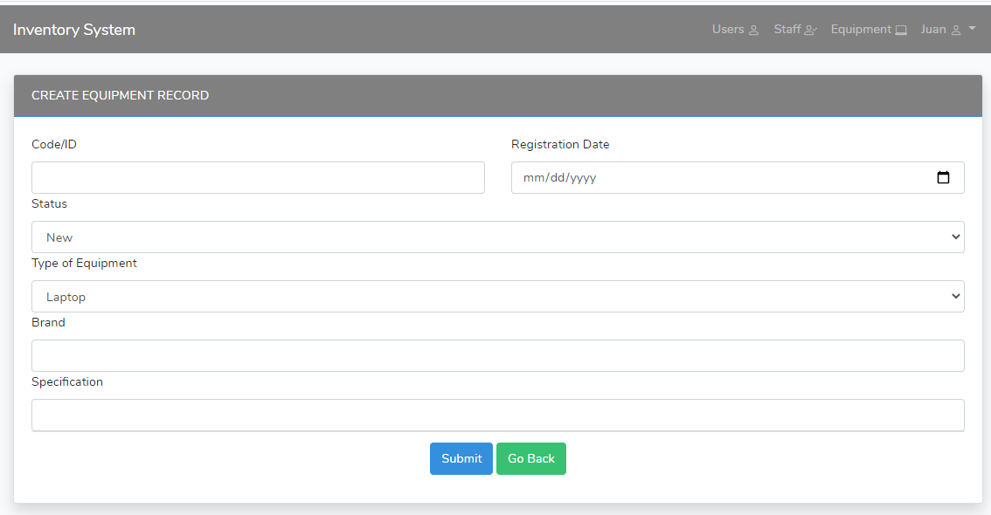
Equipment List
1
2
Legend:
Create New Equipment Record
Extract CSV file
Edit Equipment Record
Assign Form
3
4

Slide 7
Assigning Form

Slide 8
Admin Functionalities

Slide 9
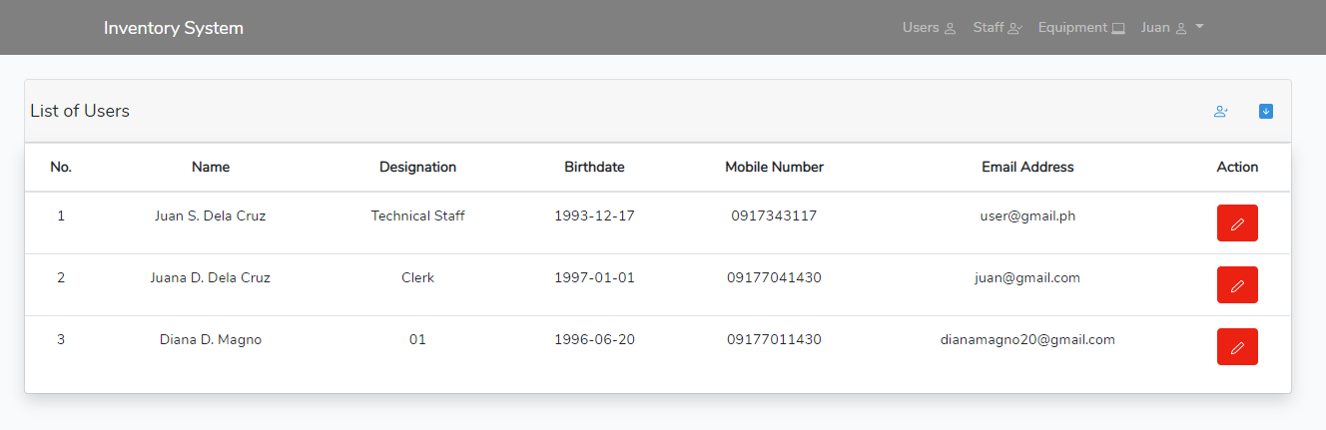
List of User/s
Legend:
Create New User Record
Extract CSV File
Edit User Record
1
2
3

Slide 10
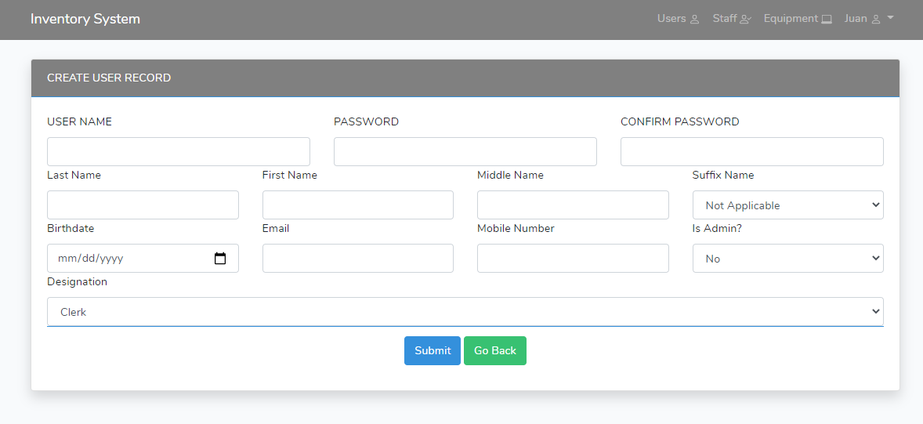
Create New User Record

Slide 11
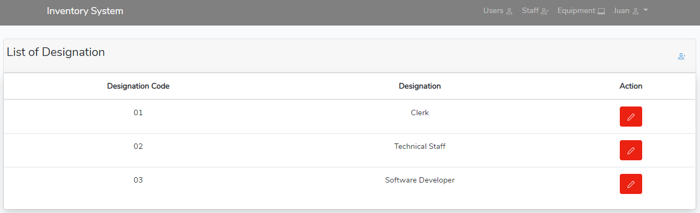
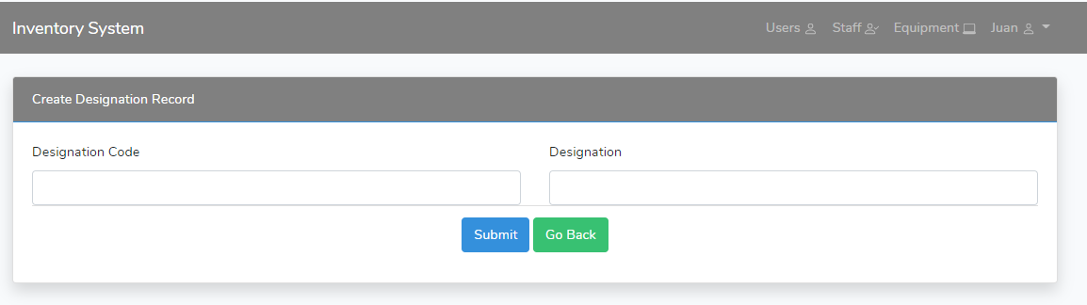
List of Designation
1
Legend:
Create New Designation
Edit Designation Record
2

Slide 12
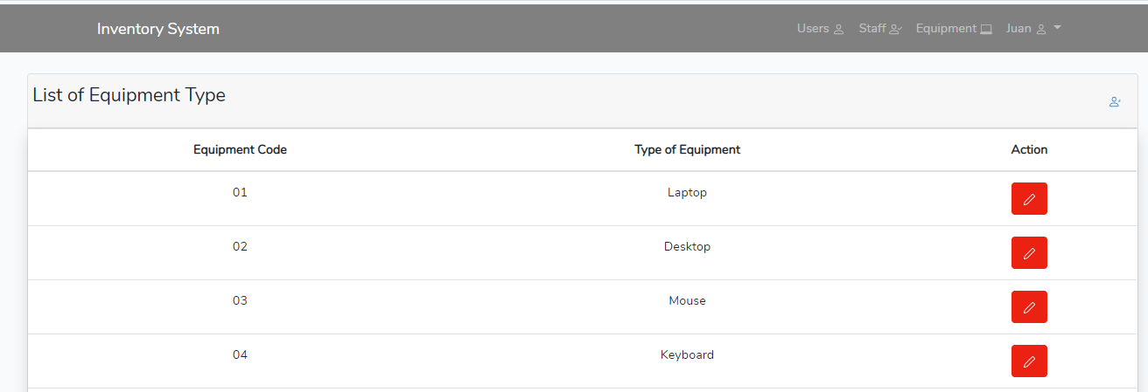
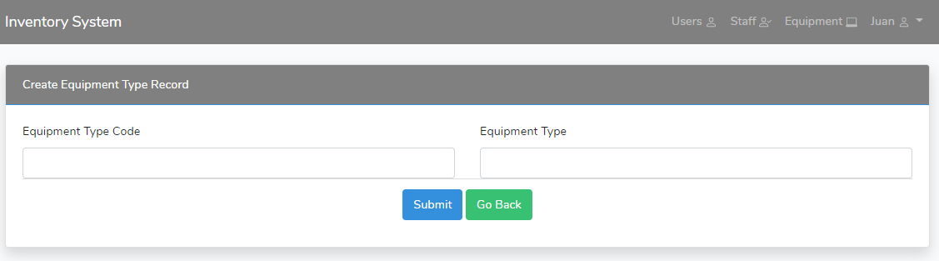
List of Equipment Type Record
1
Legend:
Create New Equipment Type
Edit Equipment Type Record
2

Slide 13
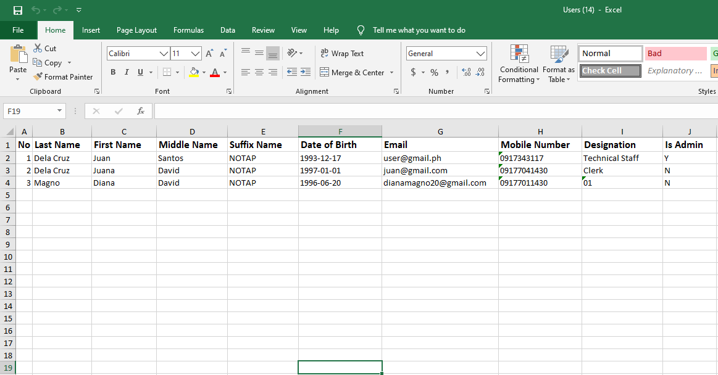
Sample Extracted CSV File

